Slide 1
Knowledge Byte
  In this section, you will learn about:
    JAXB API
    SAAJ API

Slide 2
JAXB API
  Is a Java technology that provides an API and tool that binds an XML schema to a representation in Java code.
  Provides the method for unmarshalling and marshalling.
  Used for developing an application that can read, manipulate, or recreate XML documents.
  Works as an abstraction layer between Java and an XML document because you do not need to know about the XML syntax or XML processing.

Slide 3
JAXB API (Contd.)
  Working of JAXB
    Components used while processing XML document are:
      XML Schema
      Binding Compiler
      Binding Declarations
      Binding Implementation Framework
      XML Input Document
      XML Output Document

Slide 4
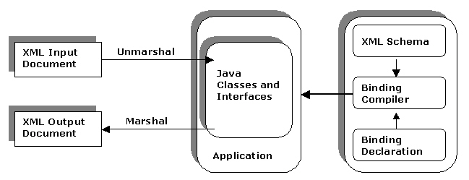
JAXB API (Contd.)
    The following figure shows the working of JAXB API:

Slide 5
JAXB API (Contd.)
  JAXB API
    Is defined in javax.xml.bind package, which contains classes and interfaces for unmarshalling, validating, and marshalling an XML document.
    Various classes contained in javax.xml.bind package are:
      JAXBContext
      Unmarshaller
      Validator
      Marshaller

Slide 6
SAAJ API
  Enables you to write SOAP messaging applications.
  Is a low-level API that contains methods to exchange messages between the clients and the Web applications.
  Enables you to write SOAP messaging applications.

Slide 7
SAAJ API (Contd.)
  SAAJ API
    SAAJ API is defined in the package, javax.xml.soap, which provides the primary abstraction for SOAP messages with attachments.
      The table list various interfaces present in the javax.xml.soap package:
Interface
Description
Detail
Represents a container to store the DetailEntry objects.
DetailEntry
Stores information about SOAPFault objects.

Slide 8
SAAJ API (Contd.)
    The table list various interfaces present in the javax.xml.soap package (Contd.):
Interface
Description
Name
Represents an XML name.
Node
Represents a node element of an XML document.
SOAPBody
Represents an object that stores the SOAP body element of a SOAP message.
SOAPBodyElement
Stores information about a SOAPBody object.

Slide 9
SAAJ API (Contd.)
    The table list various interfaces present in the javax.xml.soap package (Contd.):
Interface
Description
SOAPElement
Represents an element of a SOAP message.
SOAPHeader
Stores information about the header of a SOAP element.
Text
Represents a node that stores text.

Slide 10
SAAJ API (Contd.)
    The following table describes the classes present in the javax.xml.soap package:
Class
Description
AttachmentPart
Creates an object to attach a single attachment to a SOAPMessage object.
MimeHeader
Creates an object to store the name of the MIME header and its value.
MessageFactory
Contains methods to initialize the SOAPMessage objects.
SOAPConnection
Creates a connection object that represents a point-to-point connection. The objects of this class enable clients to send messages directly to the remote destination.

Slide 11
SAAJ API (Contd.)
    The following table describes the classes present in the javax.xml.soap package (Contd.):
Class
Description
SOAPMessage
Creates an object to store a SOAP message.
SOAPException
Creates an object that represents a SOAP exception.

Slide 12
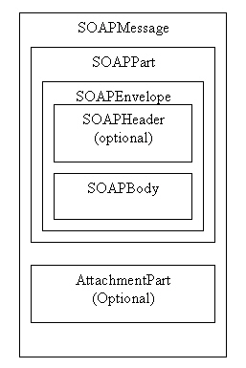
SAAJ API (Contd.)
    The following figure shows the components of SOAPMessage object:

Slide 13
From the Expert’s Desk
  This section will introduce the following:
    Best Practices on processing XML documents.
    Tips on caching techniques in XSLT to enhance performance.
    Tips on development techniques to make XSLT stylesheets manageable.
    Tips on techniques to use the import and include statements for combining stylesheets.
    FAQs on retrieving status and error information related to SOAP messages.

Slide 14
Best Practices
Processing XML Documents
  You can process XML documents using either SAX or DOM parsers.
  Use SAX parser:
    To parse large sized XML documents.
    When XML document is not nested.
  Do not use SAX parser to modify the structure of an XML document.
  Use DOM parser:
    To parse small sized XML documents.
    When you know that the entire document is to be parsed.
    When you want to access the particular element in an XML document.

Slide 15
Tips
Caching Techniques in XSLT to Enhance Performance
  You can implement caching by loading transformation information into the object of JAXP’s javax.xml.transform.Templates interface.
  You can then use the Templates object to obtain a Transformer object.
  You can reuse the Templates object to produce more transformers later and save time on stylesheet parsing and compilation.
  The following syntax shows the declaration of Templates object to obtain a Transformer object:
  Source source_xslt = new StreamSource(xslt_File);
  TransformerFactory transformerFactory = TransformerFactory.newInstance();
  Templates cached_XSLT=transformerFactory.newTemplates(source_xslt);
  Transformer transformer = cached_XSLT.newTransformer();

Slide 16
Tips (Contd.)
Development Techniques to Make XSLT Stylesheets Manageable
  Techniques to make XSLT stylesheets easily readable and manageable are:
    Using syntax highlighting editor can make the XSLT stylesheets readable.
    Adding comment blocks can make XSLT templates descriptive and breaks the repetitiveness of scanning '<' and '>' characters page by page.
    Using naming conventions for variables and parameters.
    Breaking the functionalities into different stylesheets for reusing the code with the help of <xsl:import>

Slide 17
Tips (Contd.)
Techniques to Use the Import and Include Statements for Combining Stylesheets
  Two methods to combine stylesheets are:
    The include mechanism
    The import mechanism

Slide 18
Tips (Contd.)
Techniques to Use the Import and Include Statements for Combining Stylesheets (Contd.)
    The include mechanism:
      A stylesheet is combined without changing the syntax of the stylesheet.
      A stylesheet can include another stylesheet with the help of element, <xsl:include>.
      The <xsl:include> element accepts a parameter, href whose value is a URI reference.

Slide 19
Tips (Contd.)
Techniques to Use the Import and Include Statements for Combining Stylesheets (Contd.)
    The import mechanism:
      A stylesheet overrides the other stylesheet.
      A stylesheet can be imported with the help of the statement, <xsl:import>.
      You need to use the statement, <xsl:import> within the CSS file or STYLE element.
      The statement, <xsl:import> should occur at the start of the stylesheet.

Slide 20
FAQs
  How can you retrieve status and error information when a SOAP message does not reach its destination properly?
    An object of the SOAPFault class is used to receive status and error information when the message does not reach its destination successfully.
    A SOAPFault object is present in the SOAPBody object of the message.
    A SOAPFault object informs the end user about a problem, such as an exception object.
    A SOAPFault object contains a:
      fault code: Represents the code that indicates a problem.
      fault string: Represents the fault as a String object.
      fault actor: Identifies the source of the fault.
      detail object: Represents the fault that occurs because of a SOAPBody object.

Slide 21
Challenge
    Consider the following two statements:
    Statement A: A registry is a directory provided by a service provider to publish their Web service.
    Statement B: A registry is a directory provided by a service provider to allow clients to bind with its Web service.
    Identify the correct option:
      Both statements A and B are true
      Both statements A and B are false
      Statement A is true while statement B is false
      Statement A is false while statement B is true

Slide 22
Challenge (Contd.)
    2. What does the fault string element of a SOAP message represent?
    3. The classes and interfaces of the ____________ package can be used to create and send SOAP messages from a Java application.
    4. The ___________ method allows you to parse an XML document using both SAX and DOM parsers.
    5. A ___________ document defines a Web service and are used by service providers to publish their Web service in registries.

Slide 23
Solution
    b. Both statement A and B are false
    The fault string element represents an error in the SOAP message
    javax.xml.soap
    parse()
    WSDL

